Slide 1



MERN – ES6 + React
Module 06: Bootstrap Advanced

Slide 2
Outline
Module 06
Bootstrap Intermediate
How to create Buttons
How to create Forms
How to create Navbars
How to create Grids

Slide 3
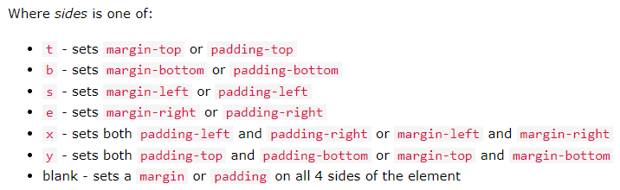
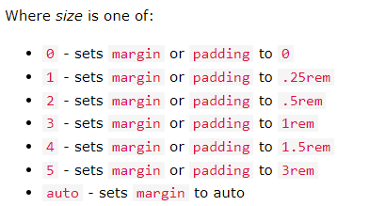
Bootstrap 5 Utilities
Spacing
The classes are used in the format:
{property}{sides}-{size} for xs
{property}{sides}-{breakpoint}-{size} for sm, md, lg, xl and xxl
Where property is one of:
m - sets margin
p - sets padding

Slide 4
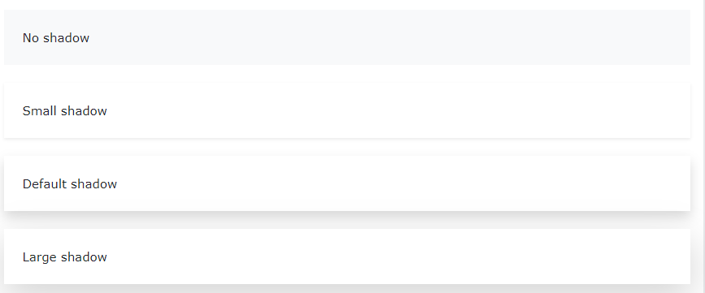
Bootstrap 5 Utilities
Shadows
Use the shadow- classes to add shadows to an element:
<div class="shadow-none p-4 mb-4 bg-light">No shadow</div> <div class="shadow-sm p-4 mb-4 bg-white">Small shadow</div> <div class="shadow p-4 mb-4 bg-white">Default shadow</div> <div class="shadow-lg p-4 mb-4 bg-white">Large shadow</div>

Slide 5
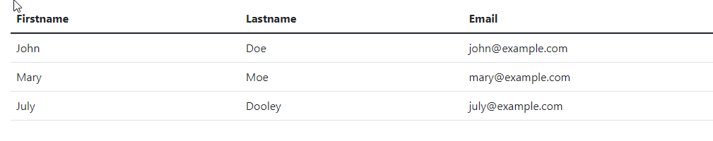
Bootstrap 5 Tables
The .table class adds basic styling to a table:
A basic Bootstrap 5 table has a light padding and horizontal dividers.
Tryit Editor Basic
Tryit Editor Stripped
Tryit Editor Hover

Slide 6
Bootstrap 5 Buttons
Button Styles
Bootstrap 5 provides different styles of buttons:
<button type="button" class="btn">Basic</button> <button type="button" class="btn btn-primary">Primary</button> <button type="button" class="btn btn-secondary">Secondary</button> <button type="button" class="btn btn-success">Success</button> <button type="button" class="btn btn-info">Info</button> <button type="button" class="btn btn-warning">Warning</button> <button type="button" class="btn btn-danger">Danger</button> <button type="button" class="btn btn-dark">Dark</button> <button type="button" class="btn btn-light">Light</button> <button type="button" class="btn btn-link">Link</button>

Slide 7
Bootstrap 5 Buttons
Button Outline
Bootstrap 5 also provides eight outline/bordered buttons.
<button type="button" class="btn btn-outline-primary">Primary</button> <button type="button" class="btn btn-outline-secondary">Secondary</button> <button type="button" class="btn btn-outline-success">Success</button> <button type="button" class="btn btn-outline-info">Info</button> <button type="button" class="btn btn-outline-warning">Warning</button> <button type="button" class="btn btn-outline-danger">Danger</button> <button type="button" class="btn btn-outline-dark">Dark</button> <button type="button" class="btn btn-outline-light text-dark">Light</button>
Tryit Editor
Move the mouse over them to see an additional "hover" effect:

Slide 8
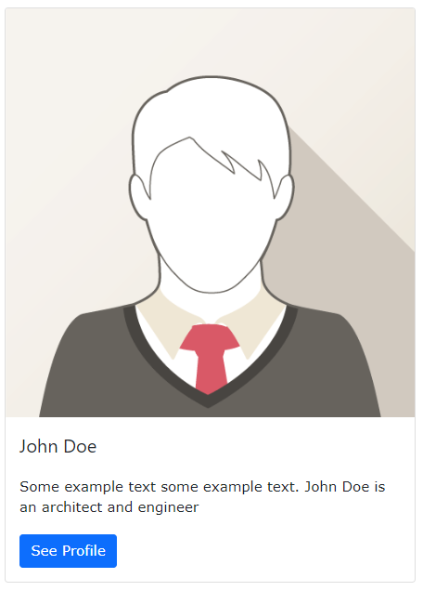
Bootstrap 5 Cards
Cards
A card in Bootstrap 5 is a bordered box with some padding around its content. It includes options for headers, footers, content, colors, etc.
<div class="card" style="width:400px"> <img class="card-img-top" src="img_avatar1.png" alt="Card image"> <div class="card-body"> <h4 class="card-title">John Doe</h4> <p class="card-text">Some example text.</p> <a href="#" class="btn btn-primary">See Profile</a> </div> </div>

Slide 9
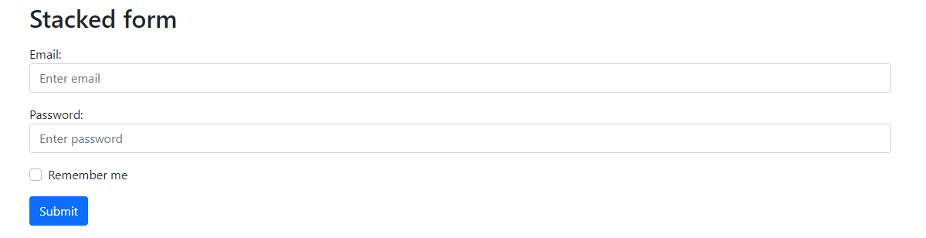
Bootstrap 5 Forms
Stacked Form
All textual <input> and <textarea> elements with class .form-control get proper form styling:
<form action="/action_page.php"> <div class="mb-3 mt-3"> <label for="email" class="form-label">Email:</label> <input type="email" class="form-control" id="email" placeholder="Enter email" name="email"> </div> <div class="mb-3"> <label for="pwd" class="form-label">Password:</label> <input type="password" class="form-control" id="pwd" placeholder="Enter password" name="pswd"> </div> <div class="form-check mb-3"> <label class="form-check-label"> <input class="form-check-input" type="checkbox" name="remember"> Remember me </label> </div> <button type="submit" class="btn btn-primary">Submit</button> </form>
Bootstrap 5 Forms

Slide 10

Bootstrap 5 Navbars
Navigation Bars
A navigation bar is a navigation header that is placed at the top of the page:
Navbar Classes
.navbar-brand
.fixed-top
.fixed-bottom
.sticky-top
Tryit Editor
Tryit Editor

Slide 11
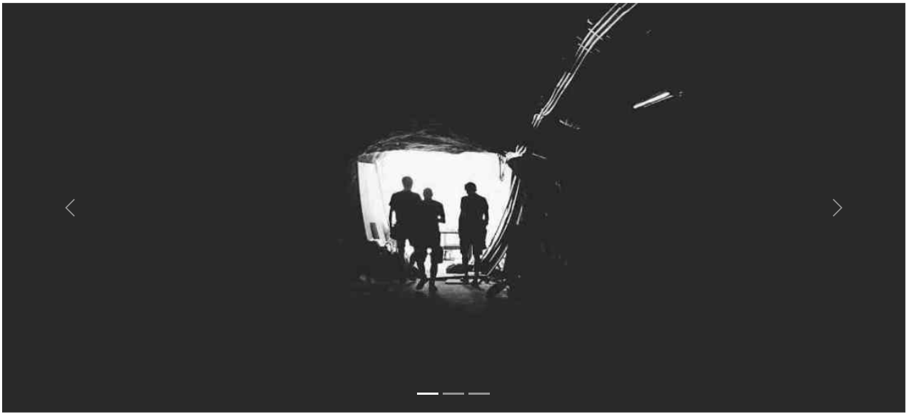
Bootstrap 5 Carousel
Carousel / Slideshow
The Carousel is a slideshow for cycling through elements:
Tryit Editor

Slide 12
Bootstrap Templates
Next step
Why is Bootstrap so popular???
Because there are so many free templates out there for use.
http://getbootstrap.com/getting-started/#example
http://www.bootstrapzero.com/
http://startbootstrap.com/
https://bootstrapmade.com/
How do you use them?
First, decide on a template that best supports your content
Download the code
Modify the HTML
Add or remove components
Bootstrap Studio - The Revolutionary Web Design Tool

Slide 13
Summary
Module 06
Bootstrap Intermediate
How to create Buttons
How to create Forms
How to create Navbars
How to create Grids

